Slide 1

ASEN 5070
Statistical Orbit Determination I
Fall 2012
Professor Jeffrey S. Parker
Professor George H. Born
Lecture 16: Numerical Compensations

Slide 2
Announcements
Homework 5 (?) and the test are graded.
Contact me within the week to challenge any grading.
Homework 6 will be graded shortly
Homework 7 due this week.
Points for quality
Guest lecturer this Thursday
Jason Leonard will speak about LiAISON Navigation
I’m unavailable Wednesday – Monday
Will be around sometimes, so you may catch me.
But I will be missing office hours – email me or call me if you have questions.

Slide 3
Exam 1 Debrief Again
I have a few corrections regarding last week’s debrief. Sorry for any confusion – I made a mistake when I announced the answers!

Slide 4
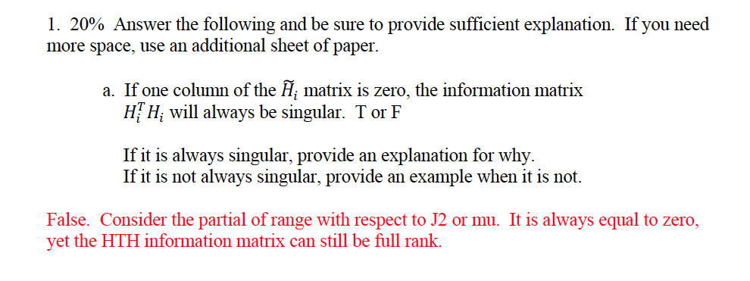
Exam 1 ReDebrief

Slide 5
Exam 1 ReDebrief
True. The transpose of a column of zeros becomes a row of zeros. That row propagates through the whole system and the H^{T}H matrix becomes singular.

Slide 6
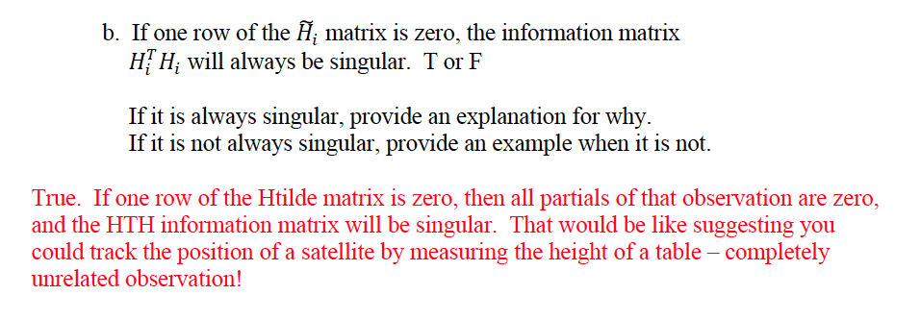
Exam 1 ReDebrief

Slide 7
Exam 1 ReDebrief
False. Consider H-tilde = [a, b, 0]^T and Phi = 1.

Slide 8
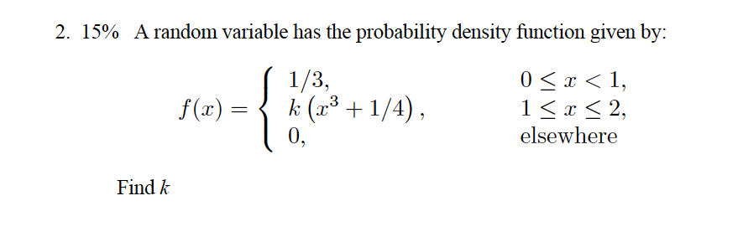
Exam 1 Debrief

Slide 9
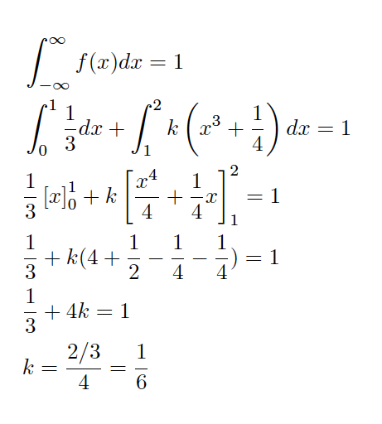
Exam 1 Debrief

Slide 10
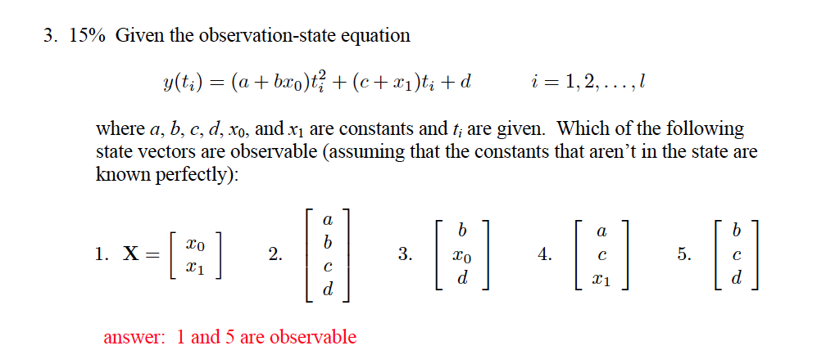
Exam 1 Debrief

Slide 11
Exam 1 Debrief

Slide 12
Exam 1 Debrief
Consider estimating c and x₁

Slide 13
Exam 1 Debrief
Consider estimating a and b

Slide 14
Exam 1 Debrief
Consider estimating b and x₀

Slide 15
Exam 1 Debrief
Consider estimating a and c

Slide 16
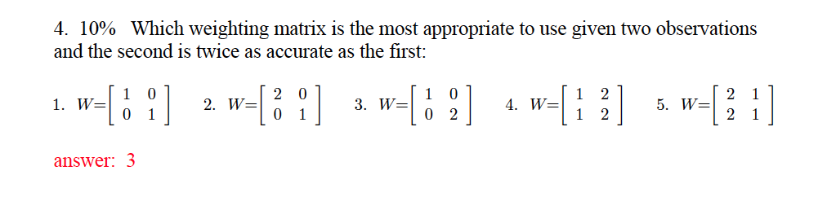
Exam 1 Debrief

Slide 17
Exam 1 Debrief

Slide 18
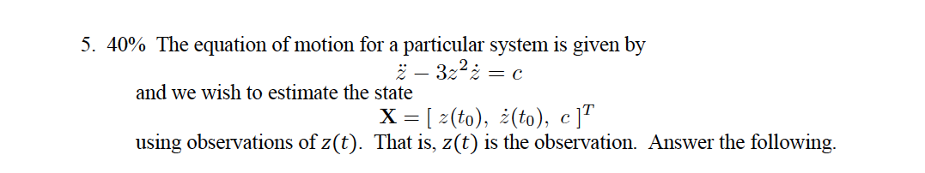
Exam 1 Debrief

Slide 19

Exam 1 Debrief

Slide 20
Exam 1 Debrief

Slide 21
Exam 1 Debrief

Slide 22
Exam 1 Debrief

Slide 23
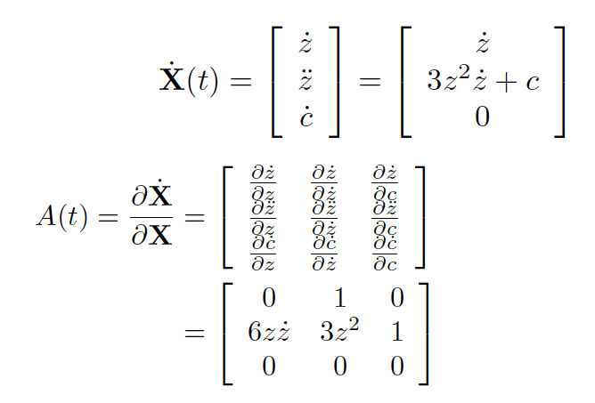
Exam 1 Debrief

Slide 24
Exam 1 Debrief

Slide 25
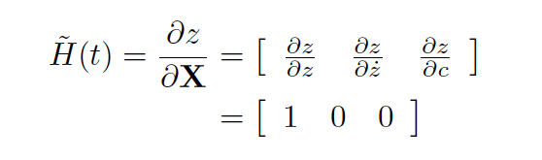
Exam 1 Debrief

Slide 26
Exam 1 Debrief

Slide 27
Exam 1 Debrief

Slide 28
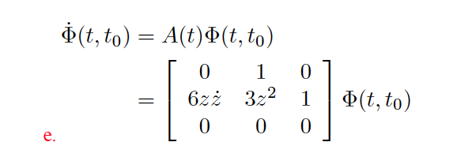
Exam 1 Debrief
Can’t use a Laplace Transform because A(t) is time-dependent!

Slide 29
Exam 1 Debrief

Slide 30

Exam 1 Debrief

Slide 31
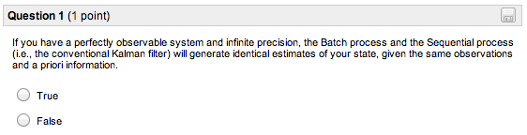
Quiz Review

Slide 32
Quiz Review

Slide 33
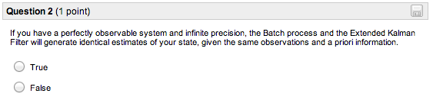
Quiz Review

Slide 34
Quiz Review

Slide 35
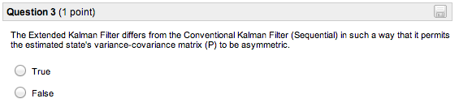
Quiz Review

Slide 36
Quiz Review

Slide 37
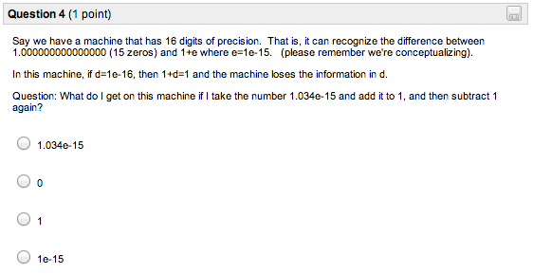
Quiz Review

Slide 38
Quiz Review
NOTE: This is a demo for why machines have limits.
Computer round-off = bad.

Slide 39
Topics
Conventional Kalman Filter (CKF)
Extended Kalman Filter (EKF)
Numerical Issues
Machine precision
Covariance collapse
Numerical Compensation
Joseph, Potter, Cholesky, Square-root free, unscented, Givens, orthogonal transformation, SVD
State Noise Compensation, Dynamical Model Compensation

Slide 40

Stat OD Conceptualization
Full, nonlinear system:

Slide 41
Stat OD Conceptualization
Linearization

Slide 42
Stat OD Conceptualization
Observations

Slide 43
Stat OD Conceptualization
Observation Uncertainties

Slide 44
Stat OD Conceptualization
Least Squares (Batch)

Slide 45
Stat OD Conceptualization
Least Squares (Batch)
Replace reference trajectory with best-estimate
Update a priori state
Generate new computed observations
Iterate a few times.

Slide 46
Side Note
Trajectory remains within the linear region longer if you model the dynamics very well.
Always a limit
ARTEMIS addressed this by deweighting older measurements
Makes sense because ARTEMIS Nav only cared about where the spacecraft is and not where it has been.

Slide 47
Conceptualization of the Conventional Kalman Filter (Sequential Filter)

Slide 48
Stat OD Conceptualization
Conventional Kalman

Slide 49
Stat OD Conceptualization
Conventional Kalman

Slide 50
Stat OD Conceptualization
Conventional Kalman

Slide 51
Stat OD Conceptualization
Conventional Kalman

Slide 52
Stat OD Conceptualization
Conventional Kalman

Slide 53
Stat OD Conceptualization
Conventional Kalman

Slide 54
Stat OD Conceptualization
Conventional Kalman

Slide 55
Stat OD Conceptualization
Conventional Kalman

Slide 56
Stat OD Conceptualization
Conventional Kalman

Slide 57
Stat OD Conceptualization
Conventional Kalman

Slide 58
Stat OD Conceptualization
Conventional Kalman

Slide 59
Stat OD Conceptualization
Conventional Kalman

Slide 60
Stat OD Conceptualization
Conventional Kalman

Slide 61
Stat OD Conceptualization
Conventional Kalman

Slide 62
Stat OD Conceptualization
Conventional Kalman

Slide 63
Stat OD Conceptualization
Conventional Kalman

Slide 64
Stat OD Conceptualization
Conventional Kalman

Slide 65
Stat OD Conceptualization
Conventional Kalman

Slide 66
Stat OD Conceptualization
Conventional Kalman

Slide 67
Stat OD Conceptualization
Conventional Kalman

Slide 68
Stat OD Conceptualization
Conventional Kalman

Slide 69
Stat OD Conceptualization
Conventional Kalman
Evolution of covariance
Mapping of final covariance

Slide 70
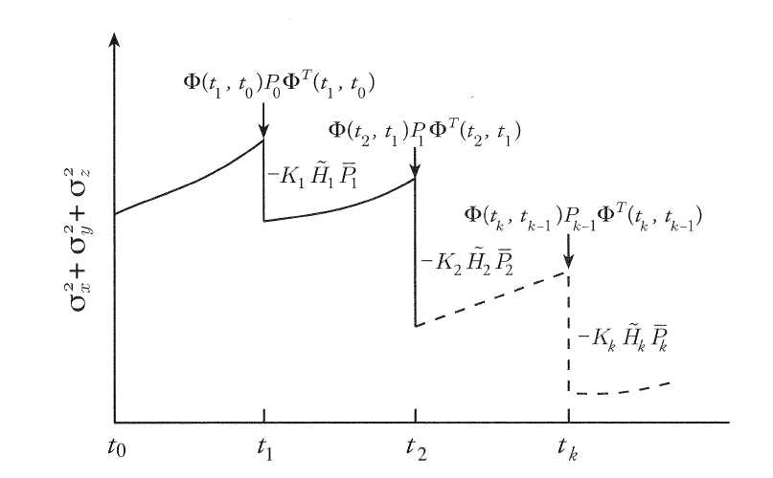
Evolution of Covariance Matrix
Evolution of the covariance matrix as observations are processed.

Slide 71
Conceptualization of the Extended Kalman Filter (EKF)
Major change: the reference trajectory is updated by the best estimate after every measurement.

Slide 72
Stat OD Conceptualization
EKF

Slide 73
Stat OD Conceptualization
EKF

Slide 74
Stat OD Conceptualization
EKF

Slide 75
Stat OD Conceptualization
EKF

Slide 76
Stat OD Conceptualization
EKF

Slide 77
Stat OD Conceptualization
EKF

Slide 78
Stat OD Conceptualization
EKF

Slide 79
Stat OD Conceptualization
EKF

Slide 80
Stat OD Conceptualization
EKF

Slide 81
Stat OD Conceptualization
EKF

Slide 82
Stat OD Conceptualization
EKF

Slide 83
Stat OD Conceptualization
EKF

Slide 84
Stat OD Conceptualization
EKF

Slide 85
Stat OD Conceptualization
EKF

Slide 86
Stat OD Conceptualization
EKF

Slide 87
Stat OD Conceptualization
EKF

Slide 88
Stat OD Conceptualization
EKF

Slide 89
Stat OD Conceptualization
EKF

Slide 90
Stat OD Conceptualization
EKF

Slide 91
Stat OD Conceptualization
EKF

Slide 92
Stat OD Conceptualization
EKF

Slide 93
Stat OD Conceptualization
EKF
Final mapped Reference
Evolution of reference, w/covariance
Original Reference

Slide 94
Stat OD Conceptualization
Linear Regime
Pitfall 1: Beware of large a priori covariances with noisy data - Breaks linear approximations - Causes filter to diverge

Slide 95
Stat OD Conceptualization
Pitfall 2: Beware of collapsing covariance - Prevents new data from influencing solution - More prevalent for longer time-spans

Slide 96
Stat OD Conceptualization
Pitfall 2: Beware of collapsing covariance - Prevents new data from influencing solution - More prevalent for longer time-spans

Slide 97
Stat OD Conceptualization

Slide 98
Stat OD Conceptualization

Slide 99
Kalman Gain’s Influence
Recall the Kalman Gain, which was formed in the derivation of the Sequential Algorithm.

Slide 100
Kalman Gain’s Influence
Recall the Kalman Gain, which was formed in the derivation of the Sequential Algorithm.
What happens if or

Slide 101
What is the Role of the Kalman Gain?
Let’s examine a simple case where & are both scalars and we observe directly, i.e.
so
Furthermore assume that is a constant so that .
Then at time k,

Slide 102
What is the Role of the Kalman Gain?
The Kalman gain @ is
The measurement update becomes

Slide 103
What is the Role of the Kalman Gain?
Hence, the best estimate of is a weighted average of the predicted
estimate and the measurement.
If the measurement is very noisy
(inaccurate) relative to the predicted state ( )
Then
and
Hence, the measurement has little effect.

Slide 104
What is the Role of the Kalman Gain?
Hence, the best estimate of is a weighted average of the predicted
estimate and the measurement.
Conversely if
and the predicted estimate has little effect.
In general the Kalman gain provides a relative weighting between the a priori and the tracking data.

Slide 105
Summary
Batch
Process all observations at once
Sequential / CKF
Process one observation at a time
Extended Kalman Filter (EKF)
Process one observation at a time and update ref.
Can be good for long arcs, if properly implemented

Slide 106
The End
Homework 5 (?) and the test are graded.
Contact me within the week to challenge any grading.
Homework 6 will be graded shortly
Homework 7 due this week.
Points for quality
Guest lecturer this Thursday
Jason Leonard will speak about LiAISON Navigation
I’m unavailable Wednesday – Monday
Will be around sometimes, so you may catch me.
But I will be missing office hours – email me or call me if you have questions.

